Slide 1
Fundamental of Data Science Fedlu Nurhussien(Ass.Proff)

Slide 2
Course Outline
Over view of Data Science
Data Revolution
Causes of the Data Revolution
Demand for Data Science and data related professions
Definition of data science
The Data Science Discipline Venn Diagram
The Identity of Data Science Discipline
Skills of data scientists
DS and its relation with other disciplines
AI-Vs Data science
Statistics
Machine Learning
Data Mining
Database System
2
Notes:
2

Slide 3
Course Outline
Sub Domains (Knowledge areas) of Data Science
Data Analytics
Data Engineering
Data Management and governance
Data Science Technologies and Tools
Research Areas in DS
Python for data analytics
Data type and operator
Popular packages
Data preprocessing
Introduction to machine learning
Supervised vs unsupervised learning
3
Notes:
3

Slide 4
Course Evaluation
Project 50%
presentation 10%
Exam 40%
4
Notes:
4

Slide 5
Data Revolution
Data is created constantly, and at an ever-increasing rate
Massive amounts of data about many aspects of our lives
Shopping, communicating, reading news, listening to music, searching for information, expressing our opinions
The finance, the medical industry, pharmaceuticals, bioinformatics, government, education, retail, and the list goes on.
Websites track every user’s on every click.
Smartphone are building up a record of our location
Smart cars collect driving habits, smart homes collect living habits, and smart marketers collect purchasing habits.
Cross-referenced encyclopedia; domain-specific databases about movies, music, sports results, pinball machines,
5
Notes:
5

Slide 6
Data Revolution
There is a growing influence of data in most sectors and most industries.
Culturally saturated feedback loop where our behavior changes the product and the product changes our behavior
Technology makes this possible:
infrastructure for large-scale data processing,
increased memory, and bandwidth, as well as a cultural acceptance of technology
6
Notes:
6

Slide 7
Big Data - a tsunami that is hitting us
We are witnessing a tsunami of data:
Huge volumes
Data of different types and formats
Impacting the business at new and ever increasing speeds
The challenges:
Capturing/collecting data
Managing
Processing - from munging the raw data to programming to provide insight into the data
Storing - safeguarding and securing
“Big Data refers to non-conventional strategies and innovative technologies used by businesses and organizations to capture, manage, process, and make sense of a large volume of data”
Notes:
We are witnessing a tsunami of huge volume of data of different types and formats that make managing, processing, storing safeguarding and securing, and transporting them a real challenge.
Big Data refers to non-conventional strategies and innovative technologies used by businesses and organizations to capture, manage, process, and make sense of a large volume of data. Ref.: Jeff Reed (2017), Data Analytics: Applicable Data Analysis to Advance Any Business Using the Power of Data Driven Analytics
The analogies:
Elephant (hence the logo of Hadoop)
Humongous (the underlying word for Mongo Database)
Streams, data lakes, oceans of data

Slide 8






Data has an intrinsic property…it grows and grows
90%
of the world’s data was created in the last two years
80%
of the world’s data today is unstructured
20%
of available data can be processed by traditional systems
1 in 2
business leaders don’t have access to data they need

Slide 9
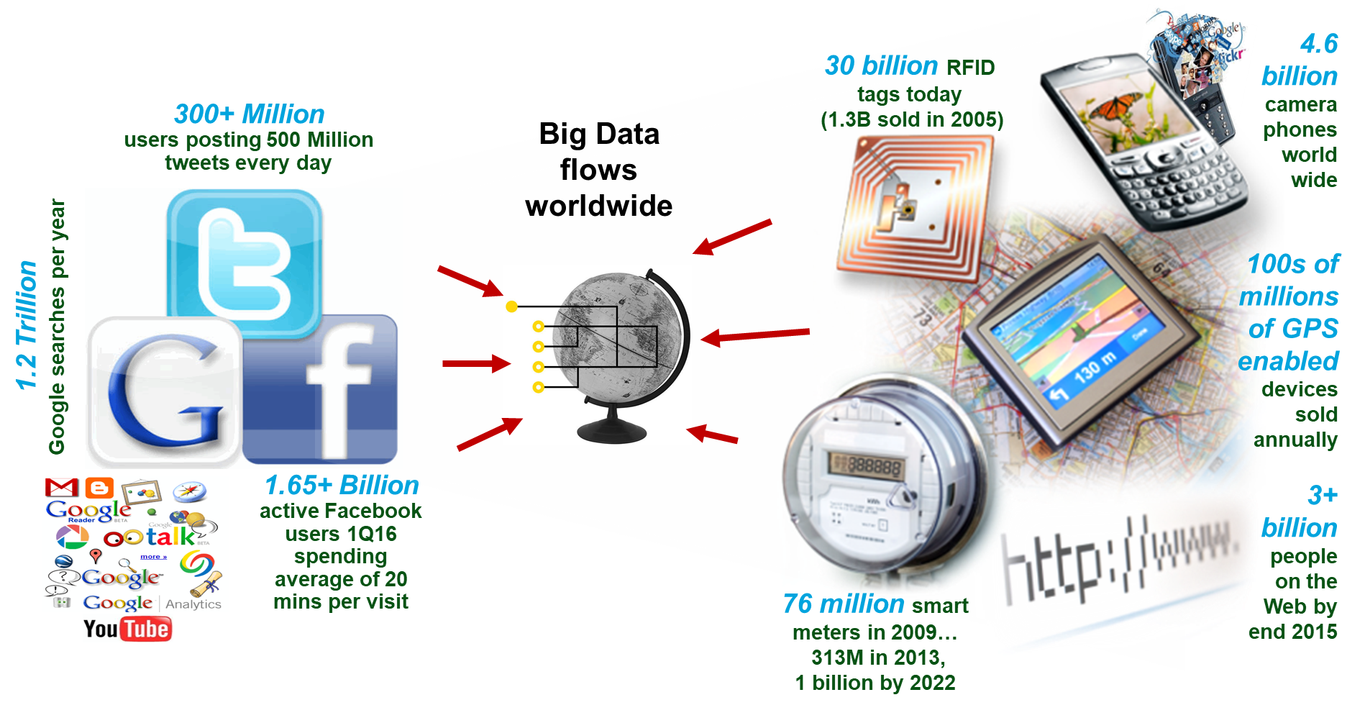
Growing interconnected & instrumented world
Notes:
Gary’s Social Media Count - webpage - http://www.personalizemedia.com/garys-social-media-count/
Passive RFID grows by 1.12 billion tags in 2014 to 6.9 billion: More than five years later than the industry had expected, market research and events firm IDTechEx find that the passive RFID tag market is now seeing tremendous volume growth.
- http://www.idtechex.com/research/articles/passive-rfid-grows-by-1-12-billion-tags-in-2014-to-6-9-billion-00007031.asp
- http://www.statista.com/statistics/299966/size-of-the-global-rfid-market/
- https://en.wikipedia.org/wiki/Radio-frequency_identification
It is Predicted This Year That 1.3 Billion RFID Tags Will Be Sold (in 2006), but This Number is Expected to Grow Rapidly over the Next Ten Years
- http://www.businesswire.com/news/home/20060124005042/en/Predicted-Year-1.3-Billion-RFID-Tags-Sold
The number of internet users has increased tenfold from 1999 to 2013. The first billion was reached in 2005. The second billion in 2010. The third billion in 2014.
- http://www.internetlivestats.com/internet-users/
Growth in the smart electric meter market has cooled during the last year, even though strong market drivers remain in place on which utilities can build a business case. Although the direct operational and societal benefits of smart meters and the broader benefits of smart grids that are enabled by smart meters continue to be debated among policymakers, utilities, regulators, and consumers, penetration rates continue to climb, reaching nearly 39 percent in North America in 2012. According to a recent report from Navigant Research, the worldwide installed base of smart meters will grow from 313 million in 2013 to nearly 1.1 billion in 2022.
- https://www.navigantresearch.com/newsroom/the-installed-base-of-smart-meters-will-surpass-1-billion-by-2022
Number of monthly active Facebook users worldwide as of 1st quarter 2016 (in millions) - http://www.statista.com/statistics/264810/number-of-monthly-active-facebook-users-worldwide/
The Top 20 Valuable Facebook Statistics - Updated April 2016
- https://zephoria.com/top-15-valuable-facebook-statistics/
Number of mobile phones to exceed world population by 2014. The ITU expects the number of cell phone accounts to rise from 6 billion now to 7.3 billion in 2014, compared with a global population of 7 billion. Over 100 countries have the number of cell phone accounts exceeding their population.
- http://www.digitaltrends.com/mobile/mobile-phone-world-population-2014/
- http://www.siliconindia.com/magazine_articles/World_to_have_more_cell_phone_accounts_than_people_by_2014-DASD767476836.html

Slide 10
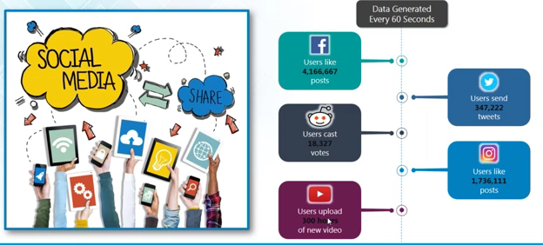
Data Revolution
eBay captures a terabyte of data per minute
Every mouse click on a web site is captured in Web log files
Machines (smart meters, Sensors, GPS, etc)
Social media sites
10
Notes:
Every minute we send 204 million emails, send 278,000 tweets, generate 1.8 million Facebook likes, and up-load 200 thousand photos to Facebook http://blog.qmee.com/wp-content/uploads/2013/07/Qmee-Online-In-60-Seconds2.png
Today’s data centers have a physical footprint of nearly 6,000 football fields. http://blog.kurtosys.com/12-big-facts-about-big-data/#.VBszDBY4S-J
It is expected that by 2020 the amount of digital information in existence will have grown from 3.2 zettabytes today to 40 zettabytes http://barnraisersllc.com/2012/12/38-big-facts-big-data-companies/
Over 90% of all the data in the world was created in the past 2 years. http://www-01.ibm.com/software/data/bigdata/
Every 2 days we create as much information as we did from the beginning of time until 2003 http://techcrunch.com/2010/08/04/schmidt-data/
10

Slide 11
Characteristics of the Data Revolution
Notes:
11

Slide 12
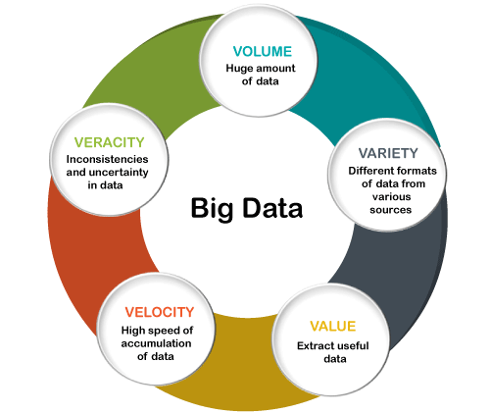
Characteristics of Big Data
March 3, 2017
16th Annual Accounting Educators Seminar - University of Missouri - Kansas City

Slide 13
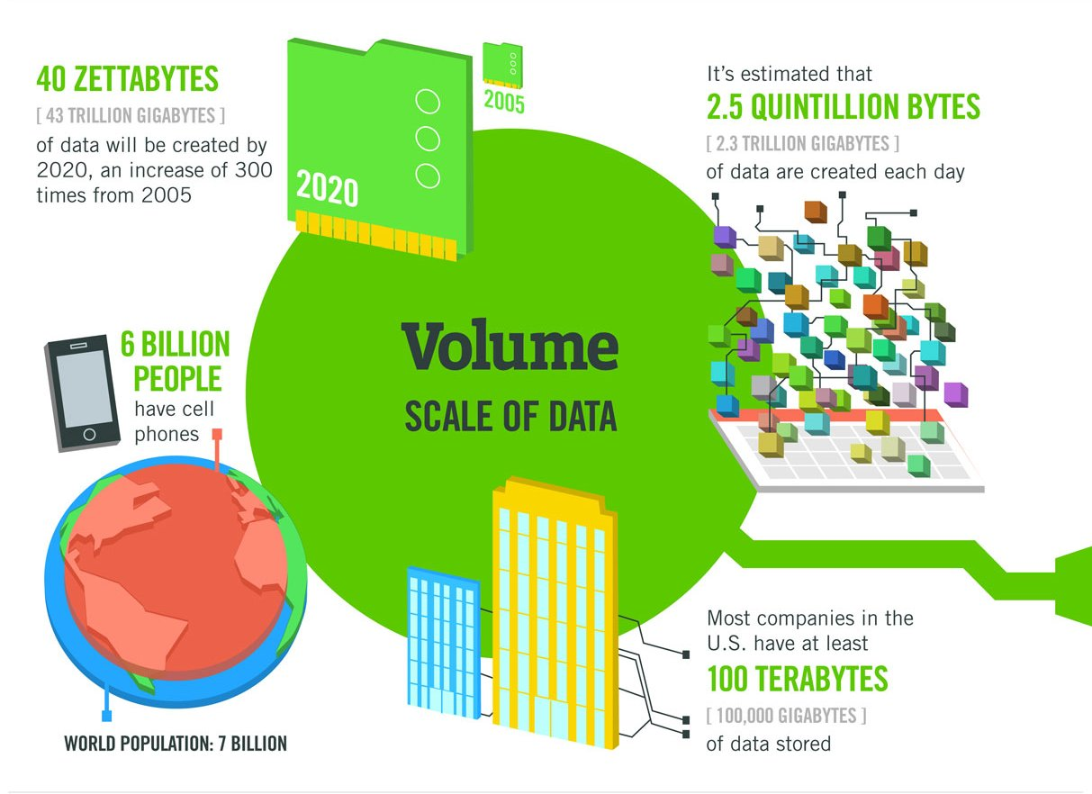
Volume

Slide 14
Volume
Many factors contribute to the increase in data volume
Transaction-based data stored through the years.
Unstructured data streaming in from social media.
Increasing amounts of sensor
Data Volume
Growth 40% per year
From 8 zettabytes (2016) to >100zb (2023)
Data volume is increasing exponentially
90% of the data is created in the past two years

Slide 15
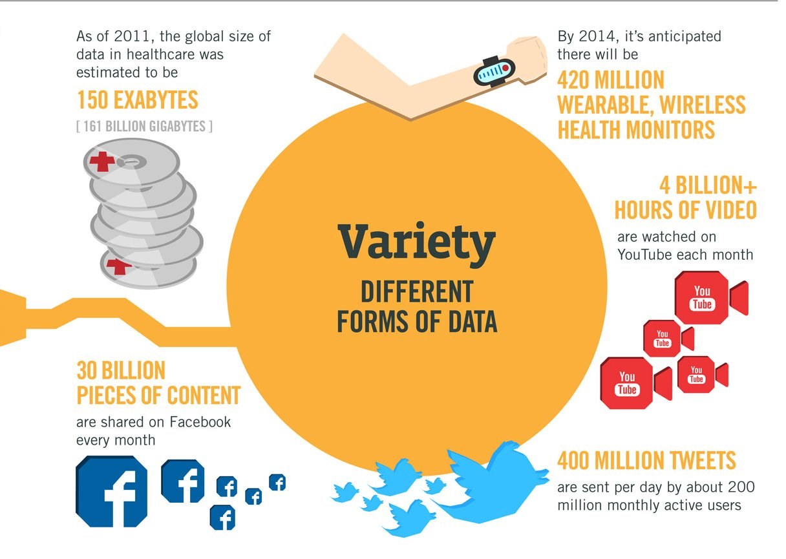
Variety

Slide 16
Variety
Data today comes in all types of formats.
Structured
Relational database , social network
Semi-structured Data
XML
Unstructured
text documents, email, video, audio
Streaming Data
Different Sources of data is also variety

Slide 17
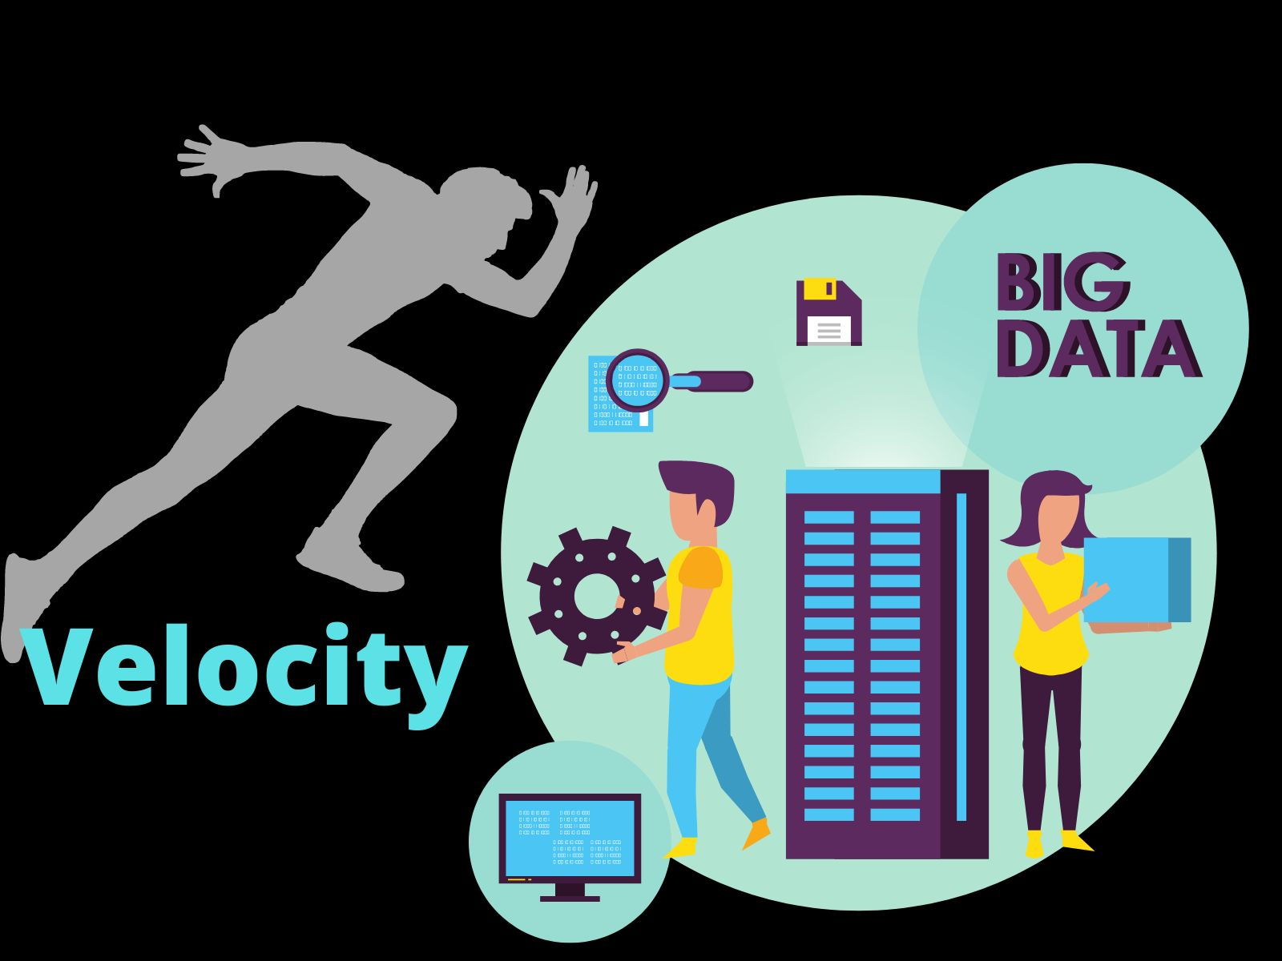
Velocity

Slide 18
Velocity
Data is streaming in at unprecedented speed and must be dealt with in a timely manner
Reacting quickly enough to deal with data velocity is a challenge for most organizations
Data is being generated fast and need to be processed fast
Late decisions = missing opportunities
Examples
E-Promotions: Based on your current location, your purchase history, what you like, should send promotions timly
Healthcare monitoring: sensors monitoring your activities
Users comments from social networking sites must be dealt timely

Slide 19
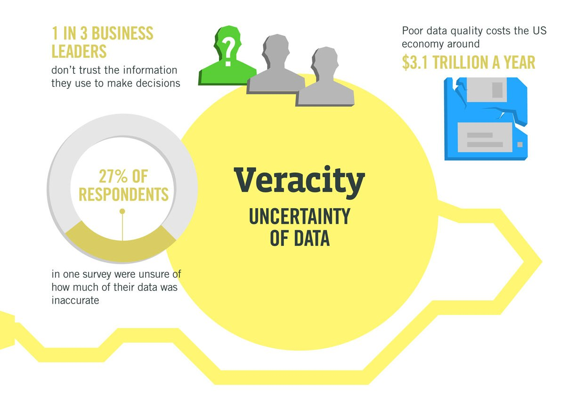
Veracity

Slide 20
Veracity
Refers to the biases, noise and abnormality in data
When we talk about big data, we typically mean its quantity:
Is a query feasible on big data within our available resources?
How can we make our queries tractable on big data?
Can we trust the answers to our queries?
Dirty data routinely lead to misleading financial reports, strategic business planning decision ⇒ loss of revenue, credibility and customers, disastrous consequences
The study of data quality is as important as data quantity

Slide 21
Causes of Data Revolution
Notes:
21

Slide 22
Causes of Data Revolution
Year | Event
1991 | World Wide Web is born
1995 | Sun releases the Java platform Global Positioning System (GPS) omnipresence in car, airplane
1999 | invents the term the Internet of Things
2001 | Wikipedia is launched
2003 | The amount of data created surpasses the amount of data created in all of human history before then LinkedIn launched, 260 million users by 2013
2004 | Facebook is launched, 1.15 billion user by 2013
2008 | The number of devices connected to the Internet exceeds the world’s population.
2011 | The IPv4 address space have all been assigned, 4.5 billion unique addresses assigned
2012 | The Obama administration announces the Big Data Research and Development Initiative

Slide 23
Causes of Data Revolution
Major derivers can be identified as the major cause
Development of the Web
Open data initiatives across the glob
Internet of Things

Slide 24
Web Technologies
Tim-Berners-Lee invented the Web in 1989
The great mind
We all love him mostly in his AAA Slogan
Anyone can say Anything about Any topic
His decision in making the web open web
Tim-Berners-Lee published two articles
Weaving the Web: The Original Design and Ultimate Destiny of the World Wide Web by Its Inventor, 1999
The Semantic Web, 2001
He claim the web that he envision is not realized

Slide 25
1. Web Technologies
Data becomes first class citizen of the Web
W3C, an authorized body to set standards in the web
Data publishing standards
HTML,XML, AJAX….
Notes:
25

Slide 26
Web Technologies
HTML
<p>The Semien Mountains National Park is established in 1969 and made a UNESCO world heritage site nine years later, the 220km square Semein Mountains National Park protects the western part of eponymous mountain range, a serious of incised plateau characterized by sheer 1,000m-high cliffs and rugged pinnacles and buttresses. The park is situated about 100km north of Gonder and best assessed from the small town of Debark. </p>
XML
<?xml version="1.0"? >
<!DOCTYPE "SemienMountains.dtd" >
<SemienMountainPark >
<FoundedIn>1969 <FoundedIn>
<RegisteredUNESCO> 1978 <RegisteredUNESCO>
<SemienMountainPark>
Notes:
26

Slide 27
Web Technologies: Monetization
Data become an important asset
Customer experience from one industry is anonymized, packaged, and sold to other industries.
Internet advertising
Yelp lets consumers share their experiences regarding restaurants, shopping, nightlife, beauty spas, active life, coffee and tea, and others.
eBay captures a terabyte of data per minute
They capture every activity of users
Mouse click, like, post, tweet, query, etc.
Every web activity can be sold/bought
Google knows more about me than I know
27
Notes:
Every minute we send 204 million emails, send 278,000 tweets, generate 1.8 million Facebook likes, and up-load 200 thousand photos to Facebook http://blog.qmee.com/wp-content/uploads/2013/07/Qmee-Online-In-60-Seconds2.png
Today’s data centers have a physical footprint of nearly 6,000 football fields. http://blog.kurtosys.com/12-big-facts-about-big-data/#.VBszDBY4S-J
It is expected that by 2020 the amount of digital information in existence will have grown from 3.2 zettabytes today to 40 zettabytes http://barnraisersllc.com/2012/12/38-big-facts-big-data-companies/
Over 90% of all the data in the world was created in the past 2 years. http://www-01.ibm.com/software/data/bigdata/
Every 2 days we create as much information as we did from the beginning of time until 2003 http://techcrunch.com/2010/08/04/schmidt-data/
27

Slide 28
2.Open Data initiatives
The world accepted open data as a tool to fight many problems
Open government data has got political commitment all over the world
A vital communications channel between governments and the public
Open data is recognized as a tool to the success of the SDGs
G8 leaders signed an Open Data Charter, promising to make public sector data openly available, without charge and in re-useable formats.

Slide 29
Open Data initiatives
Promote transparency
Allow the creation of new, innovative, added-value services
Accelerate scientific progress
Improve the quality of decision-making
providing the means for evidence-based policy development
Foster collaboration across government and beyond

Slide 30
Open Data initiatives
The open data movement is about making data public so they can be used freely by everyone.
US government data
UK government data
BBC music database
Various biological ontologies
General knowledge ontologies such as DBpedia,YAGO and Cyc
Various kinds of geographical data e.g., Geonames or OpenStreetMap
National library catalogs (USA, Germany etc.)
Scientific publications (DBLP)
Kenya open data
30

Slide 31
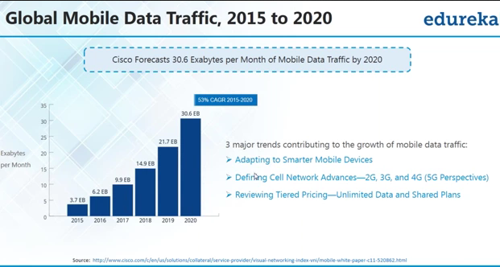
Big Data Derivers: Internet of Things
31

Slide 32
Demand for Data Science
According to US News and World Report in 2023, information security analyst, software developer, data scientist ranked among the top jobs in terms of pay and demand
Data scientist
Average annual salary: $152,279

Slide 33
Definition of Data Science
What is data science?
Is it new, or is it just statistics or analytics rebranded?
Data science is the civil engineering of data.
Big Data = Organic Data
Survey Data = Designed Data
Data Science provides ways to deal with and benefit from Big Data:
To see patterns
To discover relationships
To make sense of stunningly varied images and information.
33
Notes:
33

Slide 34
Definition of Data Science
Data science incorporates principles, techniques, and methods from many disciplines and domains including data cleansing, data management, analytics, visualization, engineering, and in the context of Big Data, now also includes Big Data Engineering.
Data science combines various technologies, techniques, and theories from various fields, mostly related to computer science and statistics, to obtain actionable knowledge from data.

Slide 35
Definition of Data Science
Data Science is a body of principles and techniques for applying data-intensive analysis to investigate phenomena, acquire new knowledge, and correct and integrate previous knowledge with measures of correctness, completeness, and efficiency of the derived results with respect to some pre-defined (top down) or emergent (bottom up) specification (scope, question, hypothesis).
35
Notes:
35

Slide 36
Definition of Data Science
DS is the combination of statistics, mathematics, programming, problem solving, the ability to look at things differently, and the activity of cleansing, preparing, and aligning the data.
In simple terms, it is the umbrella of techniques used when trying to extract insights and information from data.

Slide 37
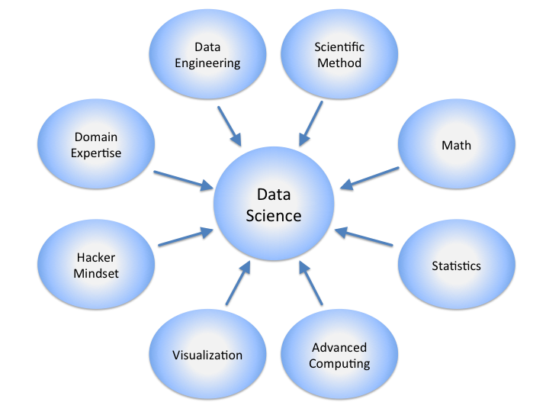
Data Science

Slide 38
DS vs STATISTICS OUT US
Statistics education deals traditionally with (small enterprises): Structured data
Data from sampling/sensus
Inferential study (estimation and hypotheses testing)
In contrast to DS/DA, Statistics deals with:
Small p and small n
Focus on statistical inference (Fisherian or Bayesian)

Slide 39
Statistical Inference
The world we live in is complex, random, and uncertain
It’s one big data-generating machine
We capture the world or certain traces of the world into data
Those captured traces will be converted into something more comprehensible, to something that somehow captures it all in a much more concise way, and that something could be mathematical models or functions of the data, in a process called statistical estimators.
This overall process of going from the world to the data, and then from the data back to the world, is the field of statistical inference.
We usually infer not from the total population but from the sample
In the age of BigData where we have all the population, the notion of taking sample may not work
The new kinds of data in BigData require us to think more carefully about what sampling means in these contexts.
How do you sample from a network and preserve the complex network structure?
39
Notes:
39

Slide 40
Data Management Systems
Relational Database Management systems
Good at structured data, with attributes such as time stamps, machine type, problem type, and operating system
They have limitation on
unstructured, quasi- or semi-structured data, such as free-form call log information taken from an e-mail ticket of the problem, customer chat history, or transcript of a phone call describing the technical problem and the solution or audio file of the phone call conversation.
Many insights could be extracted from the unstructured,quasi- or semi-structured data in the call center data.

Slide 41
 | Databases | Data Science
Data Value | “Precious” | “Cheap”
Data Volume | Modest | Massive
Examples | Bank records, Personnel records, Census, Medical records | Online clicks, GPS logs, Tweets, Building sensor readings
Priorities | Consistency, Error recovery, Auditability | Speed, Availability, Query richness
Structured | Strongly (Schema) | Weakly or none (Text)
Properties | Transactions, ACID* | CAP* theorem (2/3), eventual consistency
Realizations | SQL | NoSQL: Riak, Memcached, Apache River, MongoDB, CouchDB, Hbase, Cassandra,…
Notes:
Key-Value stores (Riak, Memcached), DHTs,
Tuple space (River), Document store (Mongo, Couch),
Column stores (Hbase, Cassandra)

Slide 42
Contrast: Databases
Databases | Data Science
Querying the past | Querying the future
Notes:
Querying the future:
What happens if I show this ad?
Or recommend this product?
Or filter this email?
Microsoft lost an estimated $1.7B on Surface computers (past) but what do they expect to make in future?

Slide 43
Machine Learning
Data Science systems
Collection and profiling of data
Distributed computing – Horizontally scalable data distribution and processing
Data visualization – Visually explore data to get a better intuition of data.The integral part of ML modeling.
Data engineering – Making sure hot and cold data is always accessible. Covers data backup, security, disaster recovery
Deployment in production mode – Migrate system into production with industry standard practices.
Automated decisions – This includes running business logic on top of data or a complex mathematical model trained using any ML algorithm.
Machine Learning modeling
Understand problem
Explore Data.
Prepare data
Select a model and train

Slide 44
Assignment
Explain the different Data formats
Html, xml, rdf,…
Review the open/data initiatives all over the world
What is the benefit of these initiatives?
What are those initiatives
What is the r/n between open data initiative and data science
Compare and contrast the different data science definitions
Come-up with the best definition
Compare data science with statistics, database system, machine learning
Is data science a new discipline as compared to the above fields
Will there be an identity confusion problem in DS?

Slide 45
Data Science Discipline Knowledge Areas
Notes:
45

Slide 46
Identified Data Science Competence Groups
Traditional/known Data Science competences/skills groups include
Data Analytics or Business Analytics or Machine Learning
Engineering or Programming
Subject/Scientific Domain Knowledge
EDISON identified 2 additional competence groups demanded by organisations
Data Management, Curation, Preservation
Scientific or Research Methods and/vs Business Processes/Operations
Other skills commonly recognized aka “soft skills” or “social intelligence”
Inter-personal skills or team work, cooperativeness
All groups need to be represented in Data Science curriculum and training programs
Challenging task for Data Science education and training
Another aspect of integrating Data Scientist into organisation structure
General Data Science (or Big Data) literacy for all involved roles and management
Common agreed and understandable way of communication and information/data presentation
Role of Data Scientist: Provide such literacy advice and guiding to organisation

Slide 47
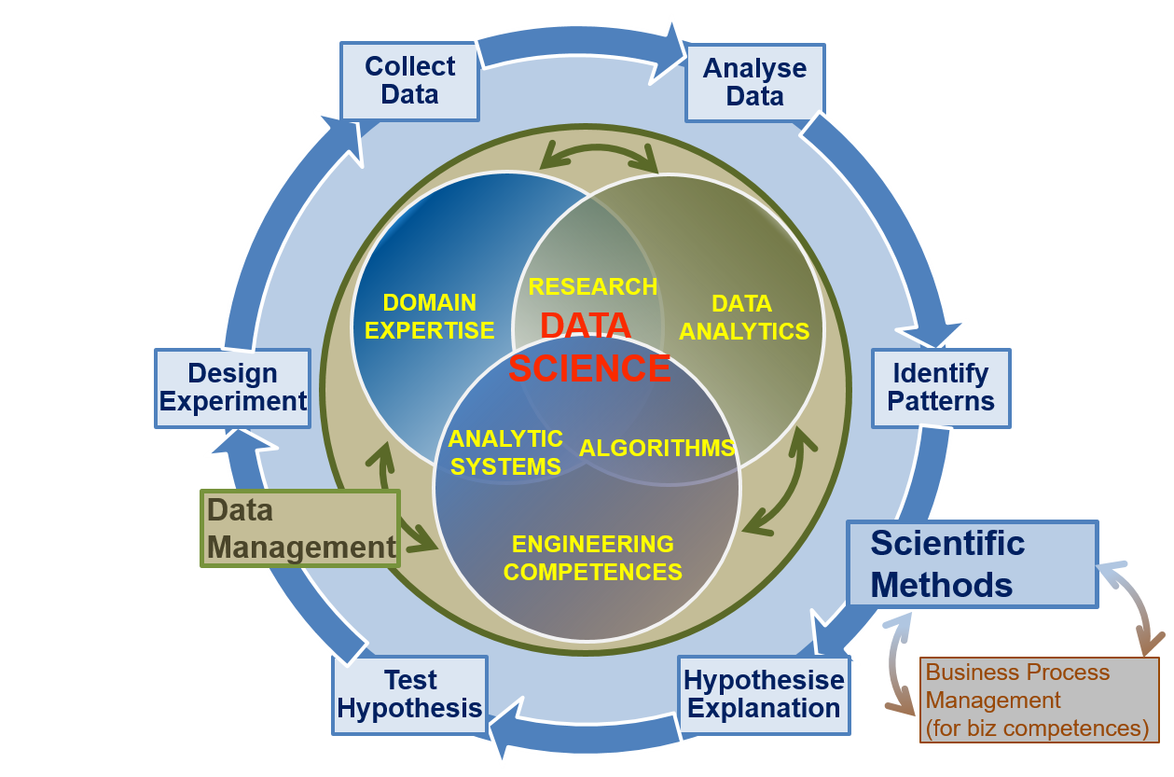
Data Science Competence Groups - Research
Data Science Competence includes 5 areas/groups
Data Analytics
Data Science Engineering
Domain Expertise
Data Management
Scientific Methods (or Business Process Management)
Scientific Methods
Design Experiment
Collect Data
Analyse Data
Identify Patterns
Hypothesise Explanation
Test Hypothesis
Business Operations
Operations Strategy
Plan
Design & Deploy
Monitor & Control
Improve & Re-design

Slide 48
Data Science Competences Groups – Business
Design
Execution
Monitoring
Modelling
Optimisation
Data Science Competence includes 5 areas/groups
Data Analytics
Data Science Engineering
Domain Expertise
Data Management
Scientific Methods (or Business Process Management)
DOMAIN
EXPERTISE
RESEARCH
DATA
ANALYTICS
DATA
SCIENCE
Scientific Methods
Design Experiment
Collect Data
Analyse Data
Identify Patterns
Hypothesise Explanation
Test Hypothesis
ANALYTIC
SYSTEMS
ALGORITHMS
ENGINEERING
COMPETENCES
Business Process Operations/Stages
Design
Model/Plan
Deploy & Execute
Monitor & Control
Optimise & Re-design
Data
Management
Business Process
Management
Scientific
Methods

Slide 49
Identified Data Science Competence Groups
 | Data Analytics (DA) | Data Management/ Curation (DM) | DS Engineering (DSE) | Scientific/Research Methods (DSRM) | DS Domain Knowledge (including Business Apps)
1 | Use appropriate statistical techniques on available data to deliver insights | Develop and implement data strategy | Use engineering principles to research, design, or develop structures, instruments, machines, experiments, processes, systems, theories, or technologies | Create new understandings and capabilities by using the scientific method's hypothesis, test, and evaluation techniques; critical review; or similar engineering research and development methods | Understand business and provide insight, translate unstructured business problems into an abstract mathematical framework
2 | Use predictive analytics to analyse big data and discover new relations | Develop data models including metadata | Develops specialized data analysis tools to support executive decision making | Direct systematic study toward a fuller knowledge or understanding of the fundamental aspects of phenomena and of observable facts, and discovers new approaches to achieve goals | Use data to improve existing services or develop new services
3 | Research and analyze complex data sets, combine different sources and types of data to improve analysis. | Integrate different data source and provide for further analysis | Design, build, operate relational non-relational databases | Undertake creative work, making systematic use of investigation or experimentation, to discover or revise knowledge of reality, and uses this knowledge to devise new applications | Participate strategically and tactically in financial decisions that impact management and organizations
4 | Develop specialized analytics to enable agile decision making | Develop and maintain a historical data repository of analysis | Develop and apply computational solutions to domain related problems using wide range of data analytics platforms | Apply ingenuity to complex problems, develop innovative ideas | Recommends business related strategic objectives and alternatives and implements them
5 |  | Collect and manage different source of data | Develop solutions for secure and reliable data access | Ability to translate strategies into action plans and follow through to completion. | Provides scientific, technical, and analytic support services to other organisational roles
6 |  | Visualise complex and variable data. | Develop algorithms to analyse multiple source of data | Influence the development of organizational objectives | Analyse multiple data sources for marketing purposes
7 |  |  | Prototype new data analytics applications |  | Analyse customer data to identify/optimise customer relations actions

Slide 50
Identified Data Science Skills/Experience Groups
A data scientist is a practitioner who has sufficient knowledge in the overlapping regimes of business needs, domain knowledge, analytical skills, and software and systems engineering to manage the end-to-end data processes in the data life cycle.
Big Data Tools and Programming Languages
Big Data Analytics platforms
Math& Stats tools
Databases
Data/applications visualization
Data Management and Curation

Slide 51
Identified Data Science Skills/Experience Groups
Group 1: Skills/experience related to competences
Data Analytics and Machine Learning
Data Management/Curation (including both general data management and scientific data management)
Data Science Engineering (hardware and software) skills
Scientific/Research Methods
Application/subject domain related (research or business)
Mathematics and Statistics
Group 2: Big Data (Data Science) tools and platforms
Big Data Analytics platforms
Math & Stats apps & tools
Databases (SQL and NoSQL)
Data Management and Curation platform
Data and applications visualisation
Cloud based platforms and tools
Group 3: Programming and programming languages and IDE
General and specialized development platforms for data analysis and statistics
Group 4: Soft skills or Social Intelligence
Personal, inter-personal communication, team work (also called social intelligence or soft skills)
Big Data Tools and Programming Languages
Big Data Analytics platforms
Math& Stats tools
Databases
Data/applications visualization
Data Management and Curation

Slide 52
Identified Data Science Skill Groups
 | Data Analytics and Machine Learning | Data Management/ Curation | Data Science Engineering (hardware and software) | Scientific/ Research Methods | Personal/Inter-personal communication, team work | Application/subject domain (research or business)
1 | Artificial intelligence, machine learning | Manipulating and analyzing complex, high-volume, high-dimensionality data from varying sources | Design efficient algorithms for accessing and analyzing large amounts of data | Interest in data science | Communication skills | Recommender or Ranking system
2 | Machine Learning and Statistical Modelling | for data improvement | Big Data solutions and advanced data mining tools | Analytical, independent, critical, curious and focused on results | Inter-personal intra-team and external communication | Data Analytics for commercial purposes
3 | Machine learning solutions and pattern recognition techniques | Data models and datatypes | Multi-core/distributed software, preferably in a Linux environment | Confident with large data sets and ability to identify appropriate tools and algorithms | Network of contacts in Big Data community | Data sources and techniques for business insight and customer focus
4 | Supervised and unsupervised learning | Handling vast amounts of data | Databases, database systems, SQL and NoSQL | Flexible analytic approach to achieve results at varying levels of precision |  | Mechanism Design and/or Latent Dirichlet Allocation
5 | Data mining | Experience of working with large data sets | Statistical analysis languages and tooling | Exceptional analytical skills |  | Game Theory
6 | Markov Models, Conditional Random Fields | (non)relational and (un)-structured data | Cloud powered applications design |  |  | Copyright and IPR
7 | Logistic Regression, Support Vector Machines | Cloud based data storage and data management
8 | Predictive analysis and statistics (including Kaggle platform) | Data management planning
9 | (Artificial) Neural Networks | Metadata annotation and management
10 | Statistics | Data citation, metadata, PID (*)

Slide 53
Possible Data Scientist profiles/roles as extension to CWA16458 (2012)
Data Analyst, Business Analyst
Data Mining
Machine Learning
Digital Librarian, Data Archivist, Data Curator, Data Steward
Data Management related competences
Data Science Engineer/Administrator/Programmer
Data analytics applications development
Scientific programming
Data Science/Big Data Infrastructure development/operation
Data Science Researcher
Data Science research methods
Data models and structures
Data Scientist in subject/research domain
Research e-Infrastructure brings its own specifics to required competences and skills definition

Slide 54
Societal Problems Addressed
Notes:
54

Slide 55
HealthCare
Medical Image Analysis
Procedures such as detecting tumors, artery stenosis, organ delineation, lung texture classification

Slide 56
HealthCare
Genetics & Genomics
Understand the impact of the DNA on our health and find individual biological connections between genetics, diseases, and drug response.
Data science techniques allow integration of different kinds of data with genomic data in the disease research, which provides a deeper understanding of genetic issues in reactions to particular drugs and diseases.

Slide 57
Retail
Customer is savvy, impatient and busy.
They want instant gratification and excellent customer service.
In order to compete and stay one step ahead, retailers need to have a 360-degree view of the customer.
Retail analytics helps businesses get deep insights into customer behavior.
It helps them understand their customer’s requirements more precisely, while also helping them to bring in more of the right kind of customers.

Slide 58
Retail
Customer is savvy, impatient and busy.
They want instant gratification and excellent customer service.
In order to compete and stay one step ahead, retailers need to have a 360-degree view of the customer.
Helps businesses get deep insights into customer behavior.
It helps them understand their customer’s requirements more precisely
It gives insights such as:
How to increase margins at a product-level?
Insights into your customer profile that helps answer questions like who they are and why they make certain purchases (Market Basket analysis)
Identify items that are likely to be purchased together.
Which marketing strategies work better than others?
ROI of marketing spend
Optimal Pricing
What promotions and offers to employ in each store?
Store wise product-mix
Personalized offers
Efficient stock strategy

Slide 59
E-commerce
Businesses can collect a wealth of information about their site, their visitors and where they came from, and use it to find new customers and increase conversions.
E- commerce businesses primarily use analytics to understand:
Acquisition - how your visitors and customers found and arrived at your site.
Shopping and purchasing behavior: how users engage with your website, which products they view, which ones they add or remove from shopping carts; along with initiating, abandoning, and completing transactions.
Economic Performance – how many products the average transaction includes, the average order value, refunds you had to issue.

Slide 60
Finance
The global financial analytics market is one of the fastest growing sectors of the data industry.
Organizations big and small are investing in financial analytics tools and technologies to solve specific business problems, reduce costs, improve budgets and get insights into future financial scenarios.
Typically financial analytics includes
Risk analysis
Working capital management
Fraud detection and prevention
Shareholder metric analysis

Slide 61
Healthcare, Education, Telecom etc
Analytics can be used for evidence based medical care, improved patient care, predicting outbreaks of diseases and reducing hospital operating costs.
Analytics is also being used to improve teaching practices. It also enables teachers to better monitor student progress, personalize learning and improve educational institutions operational efficiencies.
In the telecom industry analytics is fast gaining much ground. Operators are using analytics to drive revenue, reduce churn and improve network performance.

Slide 62
Marketing
Understanding customers and how to find more people like them is the key to sustainable growth.
Analytics can not only help companies do this but it can add value to other marketing functions as well, by gathering data across all marketing channels and consolidating it into a common marketing view.
It helps measure, manage and analyze marketing performance to maximize its effectiveness and optimize return on investment (ROI).
How are our marketing initiatives performing today?
Which of them are viable in the long run?
How can we improve those which are not effective?
How do our marketing activities compare with our competitors’?
What can we learn from our competition?
Are our marketing resources properly allocated?
Are we using the right channels?

Slide 63
Sales
Though sales analytics can help identify, model, understand and predict sales trends and outcomes we see very few companies realizing its potential to aid sales management.
However the potential is huge and over the next several years sales analytics will be one of the most important domains for Data Analytics and Big Data.
What sales analytics can essentially do is:
See what goods and services have and have not sold well.
Determine optimal inventory
Measure the effectiveness of the sales force and determine optimal sales force size
Sales incentive cost analysis
Competitor sales analysis

Slide 64
Supply chain management
Supply chain analytics helps monetize and optimize:
Current inventory status
Forecasts
Demand planning
Sourcing
Production
Improved worker productivity measurement
Transportation routing

Slide 65
Human Resource
HR analytics helps managers by creating a single view of all relevant workforce and other HR related data.
These insights can be used to make business decisions that drive business processes and initiatives and improve profitability.
Key areas where workforce related data driven analytics can be used are:
Talent acquisition and retention
Attrition
Headcount Management and Workforce Optimization
Optimization of Compensation and Benefits
Build Leadership
Performance and Career Management
Training and Development

Slide 66
Discussion
What is the difference between
Big Data Analytics
Data Mining
Data Analytics

Slide 67
What is Data Analytics?
Analytics can range from a simple exploration into how many sales of a particular product were made last year to a complex neural network model predicting which customers to target for next year’s marketing campaign.
The extensive use of data, statistical and quantitative analysis, exploratory , predictive models, and fact based management to drive decisions and actions
A key to deriving value from data is the use of analytics.
67
Notes:
67

Slide 68
What is Data Analytics?
Three ways of defining Analytics
Converting data into insights and intelligence, delivered when and where they are needed to help companies make better strategic and operational decisions
Getting data out
The use of “rocket science” algorithms (e.g., machine learning, neural networks) to analyze data

Slide 69
Three Kinds of Analytics
A key to deriving value from big data is the use of analytics
Three kinds of analytics
Descriptive analytics
Look backward and reveal what has occurred
Predictive analytics
Suggest what will occur in the future
Exploratory or discovery analytics,
Finding relationships in big data that were not previously known
Prescriptive analytics
Identify optimal solutions
what happened – what will happen – how can we make it happen

Slide 70
Example of Descriptive analytics
A sales report of Dashen Beer. This report
How many units of Beer were sold
where they were sold
what price and a lot of other things.
All you are doing is slicing and dicing the data in different ways, looking at it from different angles, along different dimensions etc.

Slide 71
Example of Predictive analytics
How many beer will be sold for next week?
Predictive analytics works by identifying patterns in historical data and then using statistics to make inferences about the future.
We try to fit the data into a certain pattern and if we believe that the data is following a certain pattern then we can predict what will happen in the future.
Retailers are very interested in understanding relationships between products. They want to know if a person buys product A, is he also likely to buy product B or C.
Let us take another example from the telecom industry.
They would love to be able to predict which of their customers are likely to leave their service in the future.

Slide 72
Example of Prescriptive analytics
Prescriptive analytics goes beyond predictive analytics by not only predicting what will happen but also suggesting the most optimal decisions given what could happen and showing what will happen under different scenarios.
It includes concepts like optimization and simulation.

Slide 73
Data Engineering

Slide 74
Data Science Engineering
Data Engineers are the link between the management's big data strategy and the data scientists that need to work with data.
What they do is building the platforms that enable data scientists to do their magic.
These platforms are usually used in four diferent ways:
Data ingestion and storage of large amounts of data
Algorithm creation by data scientists
Automation of the data scientist's machine learning models and algorithms for production use
Data visualisation for employees and customers
Most of the time these guys start as traditional solution architects for systems that involve SQL databases, web servers, SAP installations and other \standard“ systems.
But to create big data platforms the engineer needs to be an expert in specifying, set- ting up and maintaining big data technologies like: Hadoop, Spark, HBase, Cassandra, MongoDB, Kafka, Redis and more.

Slide 75
Data Science Engineering
Data Engineering skills
Without coding you cannot do much in data engineering. I cannot
Writing or quickly getting some data out of a SQL DB
Testing to produce messages to a Kafka topic
Understanding Source code of a Java Webservice
Reading counter statistics out of a HBase key value store

Slide 76
Data Science Engineering
Infrastructure and platforms for Data Science applications
Big Data Infrastructure: services and components, including data storage infrastructure
Big Data analytics platforms and tools (including Hadoop, Spark, and cloud based Big Data services)
Large scale cloud based storage and data management
Cloud based applications and services operation and management
Big Data and cloud based systems design and development
Data processing models (batch, steaming, parallel)
Data security and protection
Cloud Computing technologies for Big Data and Data Analytics
Cloud Computing architecture and services
Cloud Computing Engineering (infrastructure and services design, management and operation)
Cloud based applications and services operation and management
Infrastructure, applications and data security
Data encryption and key management, bockchain based technologies
Access Control and Identiy Management
Security services management, including compliance and certification

Slide 77
Computing Environment
90% of the world’s data was generated in the last few years
The amount of data created in every two days in 2011 is equal to the amount created in every ten minutes in 2013.
Difficult to process using traditional computing techniques
The computing environments can be
Hardware
software

Slide 78
Hard Disk
Disk capacity increased 50% to 100% per year for the last ten years
The price is almost constant
The price per terabyte has decreased by half per year
Data transfer speed to/from the disk drive increased by only 15 to 20% per year.
In 2008
Capacity was 500 GB
Transfer rate of 98 MB/sec
The entire disk takes 85 minutes
2013
Capacity 4 TB disks
Transfer rate of 150 MB/sec
The entire disk takes 440 minutes
Reading from multiples disks
E.g. 100 disks, each holding one hundredth of the data
Using only one hundredth of a disk may seem wasteful
We can store one hundredth of 100 datasets, each of which is 4 terabyte, and provide shared access to them.

Slide 79
Memory
A problem that is only 10 seconds to solve in memory will be more than 3 minutes to solve using disk
Longer processes in disk may result with disk failure
In 1980 and 1990s, there was memory constraint due to the 32‐bit operating systems which allow only 4 GB of memory to be addressed.
Around 2004, commodity hardware supported 64‐bit computing
Memory speeds have increased by 10 times compared to processor speeds, which have increased 10,000 times.
The price is dropped
Memory with high bandwidth is very expensive.
It is much less expensive to deploy a set of commodity systems with healthy amounts of memory than to purchase expensive high‐speed disk storage systems

Slide 80
Processor
The speed CPU saw dramatic improvements in the 1980s and 1990s
In the early 2000s, chip manufacturers also turned to adding extra threads of execution into their chips.
Multicore chips were scaled‐down versions of the multiprocessor supercomputers sharing resources such as cache memory.
The number of cores located on a single chip has increased over time; today many server machines offer two six‐core CPUs.
The processor speed is affected by
Clocking frequency determines maximum speed
BUS size limits capacity (I/O and processing)
Others: number of internal registers, complexity of instruction decoder, etc..

Slide 81
Processor
The graphical processing unit (GPU) has gotten considerable publicity as an unused computing resource that could reduce the run times of data mining and other analytical problems by parallelizing the computations.
The GPU is already found in every desktop computer in the world.

Slide 82
Network
The network speed should be a factor only for a distributed computing environment.
The standard network connection for an analytical computing cluster is 10 gigabit Ethernet (10 GbE), which has an upper‐bound data transfer rate of 4 gigabytes per second (GB/sec).

Slide 83
Considerations
Here are some questions to consider as you consider your high‐performance
What is the size of your data now?
What is the anticipated growth rate of your data in the next few years?
Is the data you are storing mostly structured data or unstructured data?
What data movement will be required to complete your data science projects?
What percentage of your data science projects can be solved on a single machine?
Is your data science software a good match for the computing environment you are designing?
What are your users’ biggest complaints about the current system?

Slide 84
Parallel Computing
For big data analytics, the only solution is to move the analytics to the data; it is impractical to move the data to the analytics because of the time required for the data transfer.
Co-locate the data with the compute nodes, so data access is fast because it is local
Hardware failure may happen
Avoiding data loss through replication: redundant copies of the data are kept by the system
Improve capacity by adding more computers, memory, storage
Improve hardware components: faster network, processors and/or memory.
Improve network (architecture, bandwidth & throughput):

Slide 85
Map Reduce and Hadoop

Slide 86
The MapReduce Paradigm
Platform for reliable, scalable parallel computing
Abstracts issues of distributed and parallel environment from programmer.
Runs over distributed file systems
Google File System
Hadoop File System (HDFS)
Notes:
86

Slide 87
Distributed File Systems
Highly scalable distributed file system for large data-intensive applications.
E.g. 10K nodes, 100 million files, 10 PB
Provides redundant storage of massive amounts of data on cheap and unreliable computers
Files are replicated to handle hardware failure
Detect failures and recovers from them
Provides a platform over which other systems like MapReduce, BigTable operate.
Notes:
87

Slide 88
Distributed File System
Single Namespace for entire cluster
Data Coherency
– Write-once-read-many access model
– Client can only append to existing files
Files are broken up into blocks
– Typically 128 MB block size
– Each block replicated on multiple DataNodes
Intelligent Client
– Client can find location of blocks
– Client accesses data directly from DataNode

Slide 89
HDFS Architecture
NameNode
1. filename
2. BlckId, DataNodes
o
Secondary
NameNode
Client
3.Read data
DataNodes
NameNode : Maps a file to a file-id and list of MapNodes
DataNode : Maps a block-id to a physical location on disk
Notes:
89

Slide 90
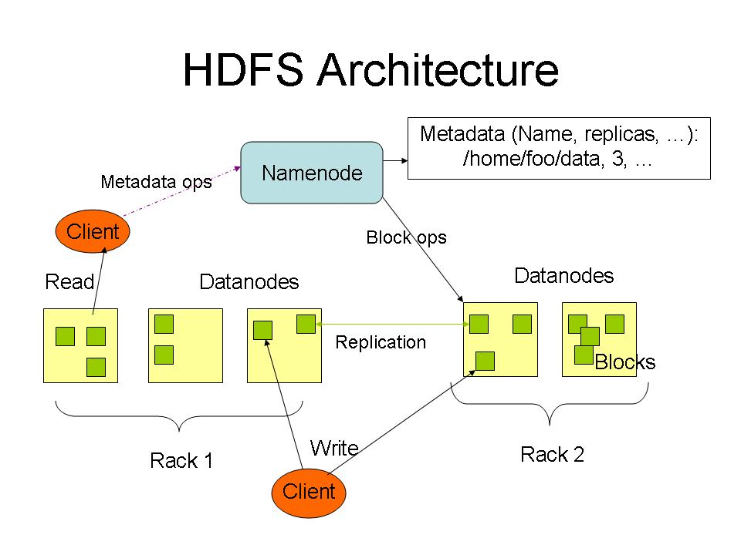

Slide 91
MapReduce: Insight
Consider the problem of counting the number of occurrences of each word in a large collection of documents
How would you do it in parallel ?
Solution:
Divide documents among workers
Each worker parses document to find all words, outputs (word, count) pairs
Partition (word, count) pairs across workers based on word
For each word at a worker, locally add up counts
Notes:
91

Slide 92
MapReduce Programming Model
Inspired from map and reduce operations commonly used in functional programming languages like Lisp.
Input: a set of key/value pairs
User supplies two functions:
map(k,v) → list(k1,v1)
reduce(k1, list(v1)) → v2
(k1,v1) is an intermediate key/value pair
Output is the set of (k1,v2) pairs
Notes:
92

Slide 93
MapReduce: The Map Step
Input
key-value pairs
Intermediate
key-value pairs
k
v
map
k1
v1
k
v
map
k2
v2
k
v
…
…
kn
vn
k
v
E.g. (doc—id, doc-content)
E.g. (word, wordcount-in-a-doc)
Adapted from Jeff Ullman’s course slides

Slide 94
MapReduce: The Reduce Step
Output
key-value pairs
Intermediate
key-value pairs
Key-value groups
reduce
k
v
k
v
v
v
k
v
reduce
k
v
k
v
v
k
v
group
k
v
…
…
…
k
v
k
v
k
v
E.g. (word, wordcount-in-a-doc)
(word, list-of-wordcount)
(word, final-count)
~ SQL Group by
~ SQL aggregation
Adapted from Jeff Ullman’s course slides

Slide 95
Pseudo-code
map(String input_key, String input_value):
// input_key: document name
// input_value: document contents
for each word w in input_value:
EmitIntermediate(w, "1");
// Group by step done by system on key of intermediate Emit above, and // reduce called on list of values in each group.
reduce(String output_key, Iterator intermediate_values):
// output_key: a word
// output_values: a list of counts
int result = 0;
for each v in intermediate_values:
result += ParseInt(v);
Emit(AsString(result));
Notes:
95

Slide 96
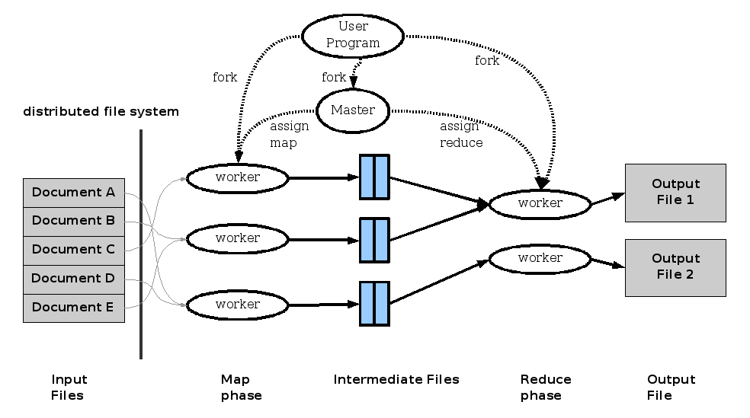
MapReduce: Execution overview
Notes:
96

Slide 97
Distributed Execution Overview
User
Program
fork
fork
fork
Master
assign
map
assign
reduce
input data from
distributed file
system
Worker
write
Output
File 0
local
write
Worker
Split 0
read
Split 1
Worker
Split 2
Output
File 1
Worker
Worker
remote
read,
sort
From Jeff Ullman’s course slides

Slide 98
Map Reduce vs. Parallel Databases
Map Reduce widely used for parallel processing
Google, Yahoo, and 100’s of other companies
Example uses: compute PageRank, build keyword indices, do data analysis of web click logs, ….
Database people say: but parallel databases have been doing this for decades
Map Reduce people say:
we operate at scales of 1000’s of machines
We handle failures seamlessly
We allow procedural code in map and reduce and allow data of any type

Slide 99
Data Management group: data curation, preservation and data infrastructure
Data Governance
Data Architecture
Data Modelling and Design
Data Storage and Operations
Data Security
Data Integration and Interoperability
Documents and Content
Reference and Master Data
Data Warehousing and Business Intelligence
Metadata
Data Quality
PID, metadata, data registries
Data Management Plan
Open Science, Open Data, Open Access, ORCID
Responsible data use

Slide 100
Data curation, preservation and data infrastructure

Slide 101
Data curation, preservation and data infrastructure
– This sub discipline includes Knowledge Areas
Data Modelling and Design,
Data Governance,
Data Storage and Operations,
Data Security,
Data Integration and Interoperability,
Documents and Content,
Reference and Master Data,
Data Quality
PID, metadata, data registries
Data Management Plan
Open Science, Open Data, Open Access, ORCID

Slide 102
History of the Web
Semantic Web is build upon artificial intelligence
The problem of AI is scientific one but the SW is technology adoption (engineering )
The goal of SW is not to reach human-level intelligence
In SW, partial solutions work.
Even if an intelligent agent is not able to come to all conclusions that a human user might draw, the agent will still contribute to a Web much superior to the current Web.

Slide 103
History of the Web
Measures Taken by W3C
Introduce the Semantic Web
W3c has set a standard for data exchange
A graphical data model (aka. RDF)
Data become first class citizen of the Web
Publishing document is not encouraged
Notes:
103

Slide 104
History of the Web
Resources
A thing we want to talk about
E.g. authors, books, publishers, places, people, hotels
Properties
Describe relations between resources
E.g. “written by”, “age”, “title”, etc.
Statements
A statement is an object-attribute-value triple
It consists of a resource, a property, and a value
Values can be resources or literals
Subject, predicate, object (DBpedia, YAGO)
(dbr:Ethiopia, dbo:Capital, dbr:Addis_Ababa)

Slide 105
History of the Web
Large Scale Knowledge Graphs are published
Knowledge bases that are published using RDF data model
Provide semantically structured information that is interpretable by computers
Some of these knowledge graphs are
YAGO
DBpedia
freebase
WikiNet:
Notes:
105

Slide 106
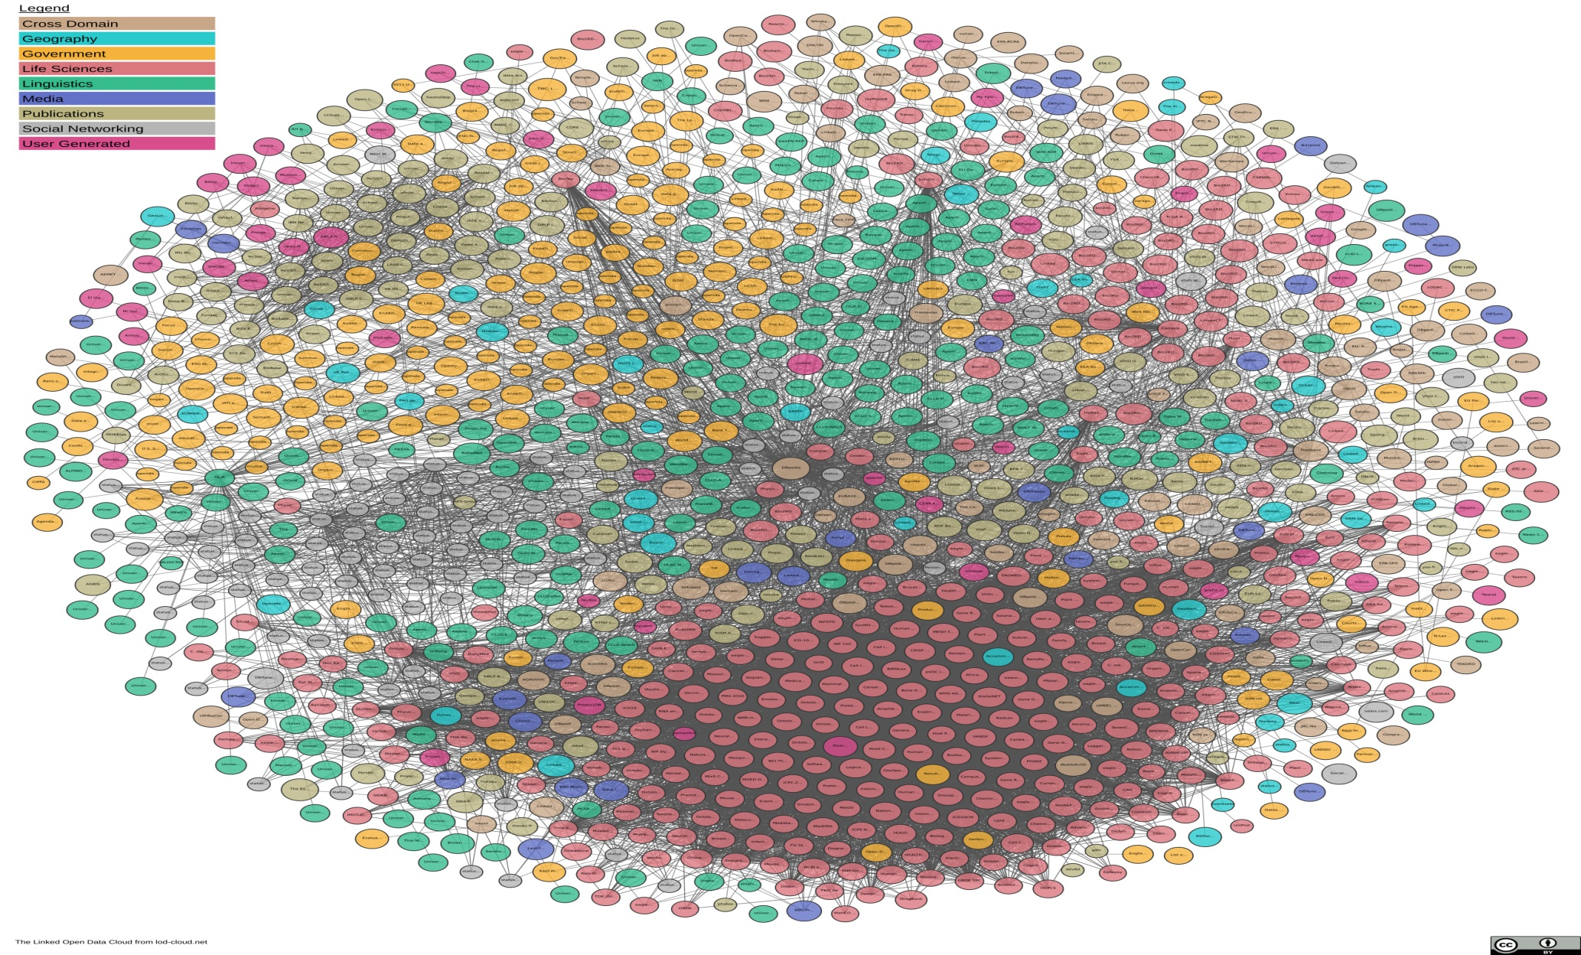
Linked Open Data Project
1239 datasets
80 B facts
106

Slide 107
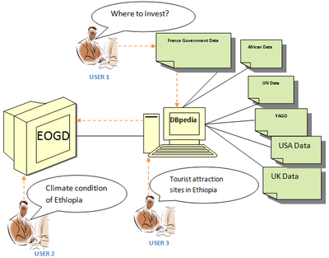
Value of Links

Slide 108
Application of MRKG
The next generation IR goals can be achieved by KG
Query answering is the goal of next generation IR
Provide Summaries
Find facts
Google Knowledge Graph
Satori, Microsoft’s Bing
Watson, IBM
Win human Experts
Use DBpedia, YAGO, Freebase as a source

Slide 109
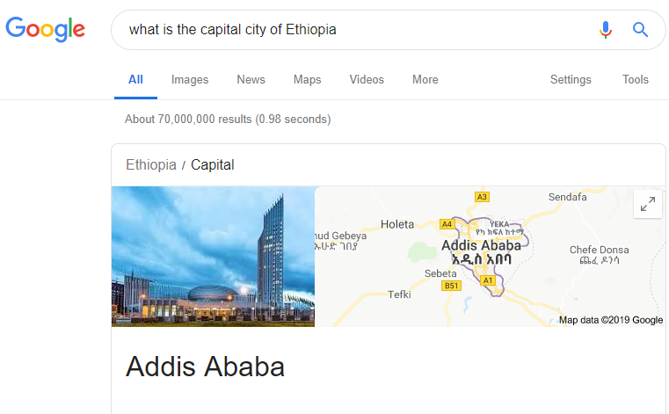
Google Knowledge Graph
Find the right thing
What is the capital city of Ethiopia?

Slide 110
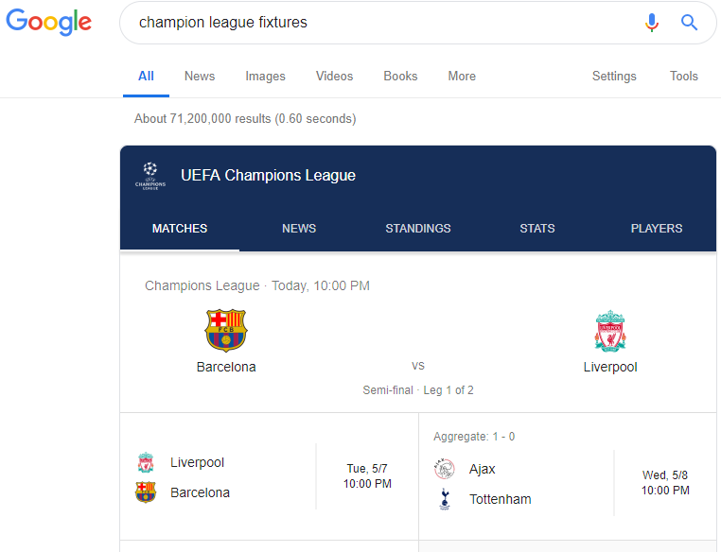
Google Knowledge Graph
Find the right thing
Champions League fixtures

Slide 111
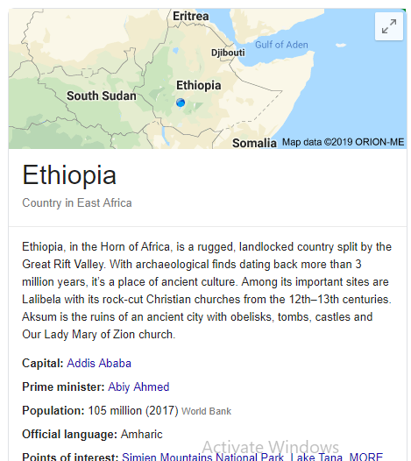
Google Knowledge Graph
Summaries
Summarize relevant content around that topic, including key facts about the entity

Slide 112
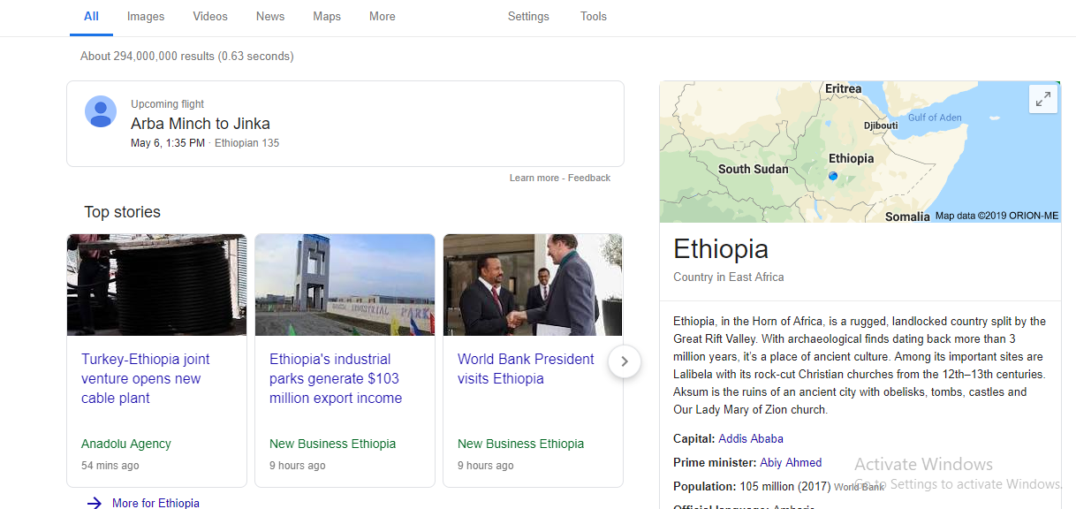
Google Knowledge Graph
Deeper and broader information
reveal new facts

Slide 113
Why Data Governance?
Data Governance (DG) is an organizational approach to data and information management
Helps to protect interests of stakeholders by enforcing compliance with agreed-upon rules and regulations regarding data management (including security)
Outlines who can take what actions, when, with what information, and using what methods
Defines rules of engagement, organizational bodies, accountable individuals, and processes
Is formalized as a set of policies and procedures
Encompasses the full data life-cycle

Slide 114
Data Governance Program: Scope
Scope of a DG program with focus on privacy, compliance, and security includes
Protection of sensitive data
Vulnerability assessment and risk mitigation
Enforcement of regulatory, contractual, and architectural compliance requirements
Identification of stakeholders, decision rights, and accountabilities
Access management

Slide 115
DG Program Implementation: Key Steps
Decision-making authority: Establish organizational structure with different levels of DG & specify roles and responsibilities at each level
Standard policies & procedures: Adopt and enforce a written data governance plan
Data inventory: Conduct an inventory of all data that require protection
Data content: Identify the purposes for which data are collected and justify the collection of sensitive data
Data records: Specify activities related to handling data to ensure compliance with security policies

Slide 116
DG Program Implementation: Key Steps contd.
Data quality: Ensure that data are accurate, relevant, timely, and complete for the purposes they are collected
Data access: Define and assign differentiated levels of data access to individuals based on their roles and responsibilities
Data security: Ensure the security of sensitive data by mitigating the risks of unauthorized disclosure
Data dissemination: Ensure that data sharing and reporting activities comply with federal, state, and local laws

Slide 117
Data Integration and Interoperability

Slide 118
Initial Phase
W3C SWEO Linking Open Data Project
Project aims to
Publish existing open license datasets as linked data on the web
Interlink things between different data sources
Develop clients and applications that consume linked data from the web
Formed linked open data cloud

Slide 119
LOD in May 2007
Over 500M RDF triples
Around 120K RDF links between data sources

Slide 120
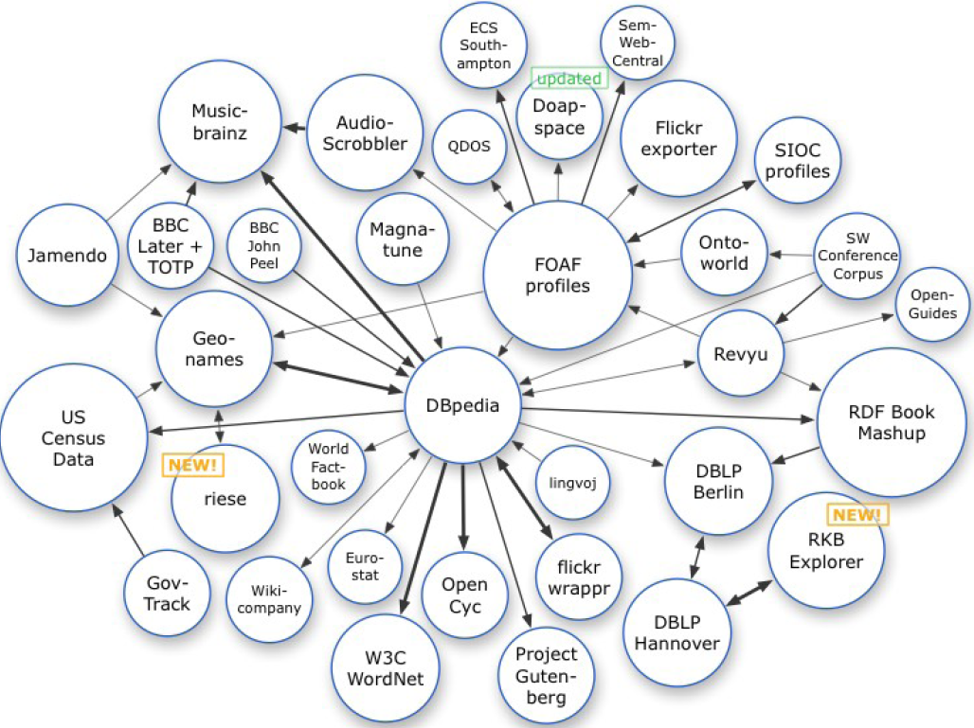
LOD in April 2008
>2B RDF triples
Around 3M RDF links

Slide 121
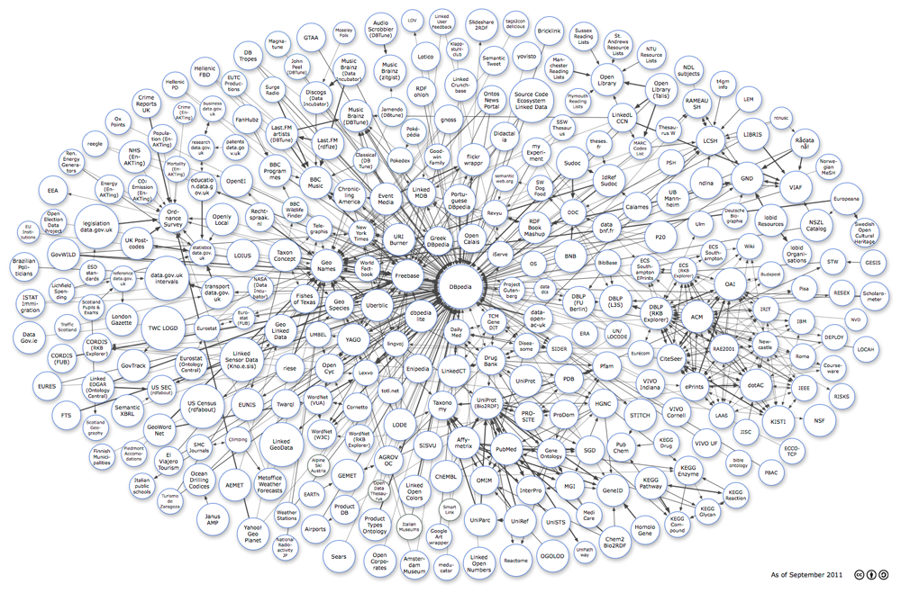
2011

Slide 122

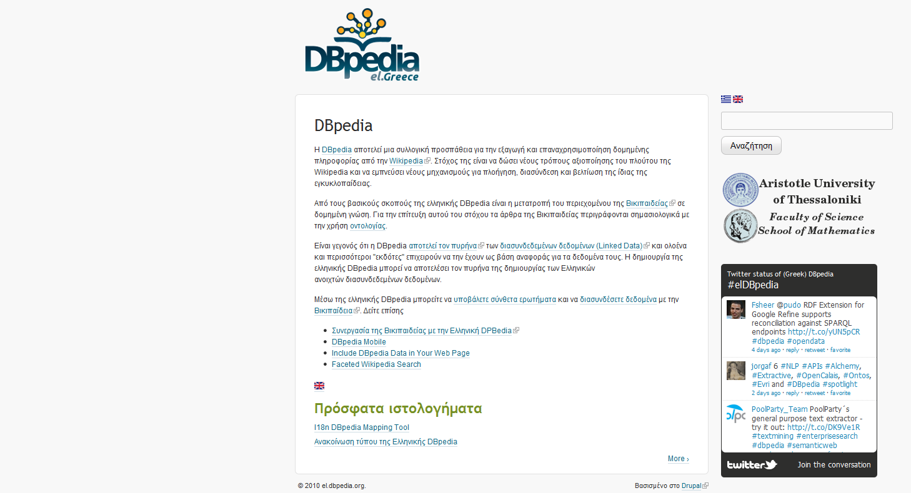
122

Slide 123
DBpedia (cont’d)
DBpedia, like other ontologies we will see below, is different than Cyc and WordNet. Here the emphasis is on individuals, not general knowledge about various domains.
DBpedia is written in RDF and it is part of the Linked Open Data effort.
123

Slide 124
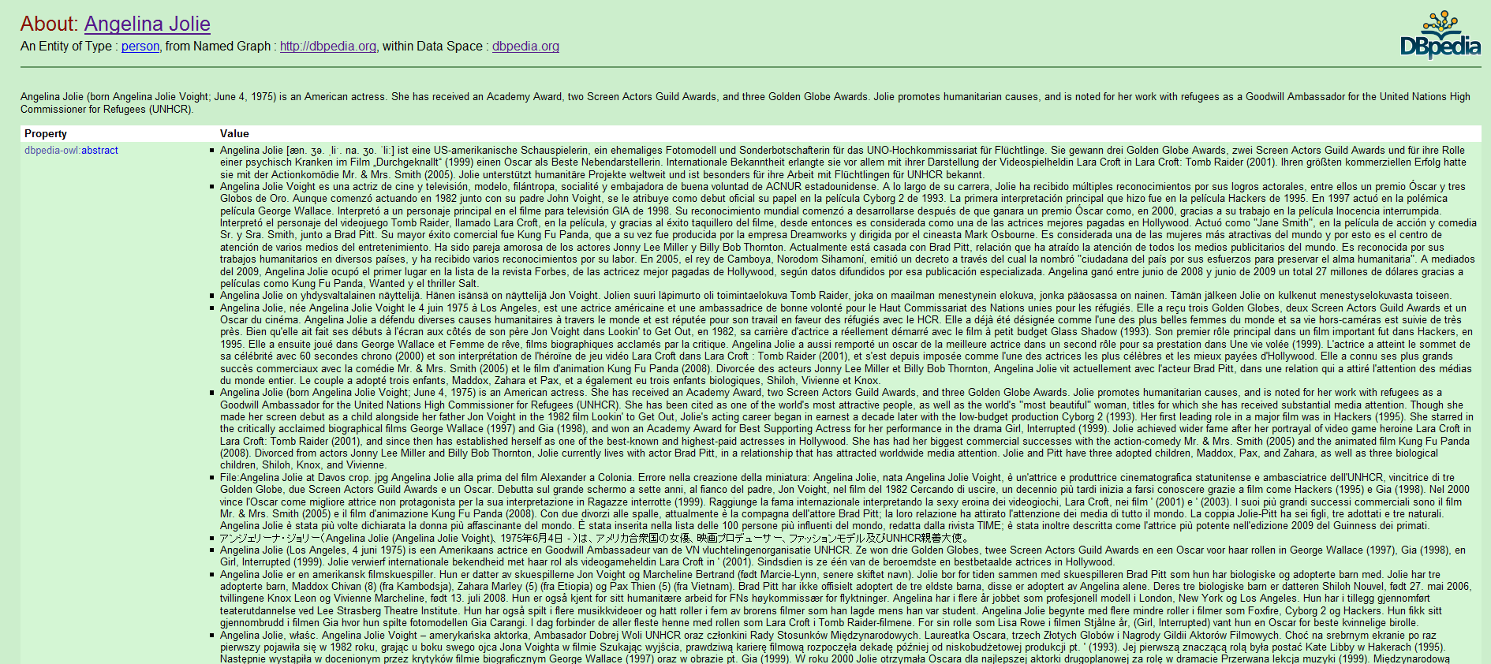
http://dbpedia.org/page/Angelina_Jolie
124

Slide 125
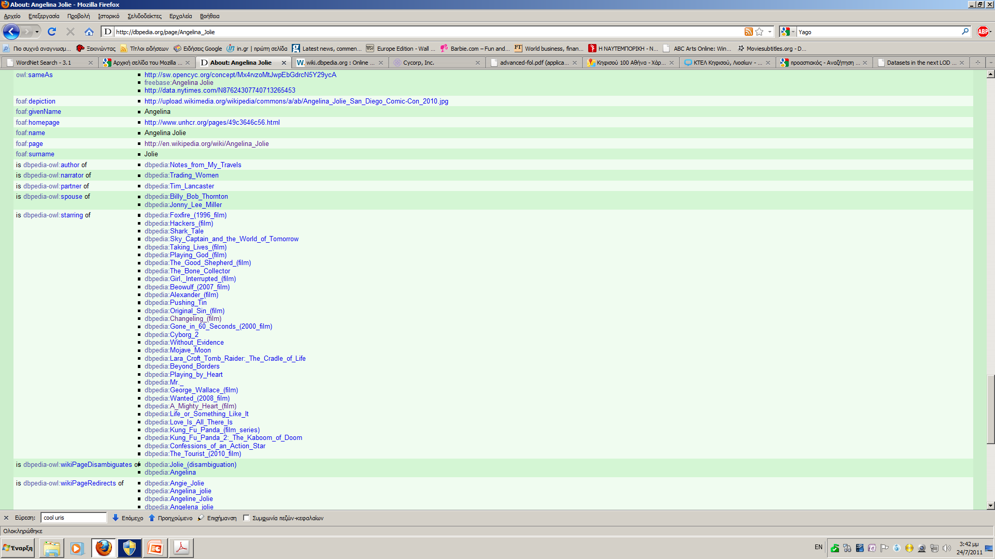
http://dbpedia.org/page/Angelina_Jolie
125

Slide 126
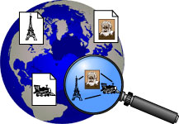
YAGO
From the YAGO Web page (http://www.mpi-inf.mpg.de/yago-naga/yago/):
YAGO2 is a huge semantic knowledge base, derived from Wikipedia, WordNet and GeoNames. Currently, YAGO2 has knowledge of more than 10 million entities (like persons, organizations, cities, etc.) and contains more than 80 million facts about these entities.
In YAGO2, we made an effort to treat time and location data as first-class citizens, extending the basic triple model by special fields for time and location for querying. Also, we took special care to consistently attach temporal and spatial data to all facts where it is semantically meaningful and where time and location can be derived from Wikipedia.
126

Slide 127
Freebase
From the Freebase Web site (http://www.freebase.com/):
Freebase is an open, Creative Commons licensed repository of structured data of almost 20 million entities.
An entity is a single person, place, or thing. Freebase connects entities together as a graph.
Freebase is now owned by Google and its Knowledge Graph technology builds on it.
127

Slide 128
Data Privacy and Security
● Individual rights and impact on needs of society.
● Technologies to safeguard data privacy.
● Relationships between individuals, organizations, and
governmental privacy requirements.
128

Slide 129
Use cases for a Big Data platform: Healthcare and Life Sciences
Problem:
Vast quantities of real-time information are starting to come from wireless monitoring devices that postoperative patients and those with chronic diseases are wearing at home and in their daily lives.
How big data analytics can help:
Epidemic early warning
Intensive Care Unit and remote monitoring

Slide 130
Precision Medicine Initiative (PMI) & Big Data
Precision Medicine
A medical model that proposes the customization of healthcare, with medical decisions, practices, and/or products being tailored to the individual patient - Wikipedia
Diagnostic testing is often employed for selecting appropriate and optimal therapies based on the context of a patient’s genetic content or other molecular or cellular analysis
Tools employed in PM can include molecular diagnostics, imaging, and analytics/software
The Precision Medicine Initiative (PMI)
A $215 million investment in President Obama’s Fiscal Year 2016 Budget to accelerate biomedical research and provide clinicians with new tools to select the therapies that will work best in individual patients
Notes:
Graphic on the right (from the National Cancer Institute) illustrates the use of precision medicine in cancer treatment. “Discovering unique therapies that treat an individual’s cancer base on the specific genetic abnormalities of that person’s tumor.
Precision Medicine Initiative (PMI) references:
Obama’s Precision Medicine Initiative Is The Ultimate Big-Data Project - “Curing both rare diseases and common cancers doesn't just require new research, but also linking all the data that researchers already have” http://www.fastcompany.com/3057177/obamas-precision-medicine-initiative-is-the-ultimate-big-data-project
White House https://www.whitehouse.gov/precision-medicine
Obama: Precision Medicine Initiative Is First Step to Revolutionizing Medicine - "We may be able to accelerate the process of discovering cures in ways we've never seen before," the president said http://www.usnews.com/news/articles/2016-02-25/obama-precision-medicine-initiative-is-first-step-to-revolutionizing-medicine
National Institutes of Health https://www.nih.gov/precision-medicine-initiative-cohort-program
National Cancer Institute http://www.cancer.gov/research/key-initiatives/precision-medicine
Precision Medicine (Wikipedia) https://en.wikipedia.org/wiki/Precision_medicine

Slide 131
Use cases for a Big Data platform: Financial Services
Problem:
Manage the several Petabytes of data which is growing at 40-100% per year under increasing pressure to prevent frauds and complaints to regulators
How big data analytics can help:
Fraud detection
Credit issuance
Risk management
360° view of the Customer

Slide 132
Social Media Sentiment Analysis
To monitor feedback and automate the actions taken in response to the feedback
Combines consumer feedback expressed publicly on the social media and the feedback is combined into “positive” or “negative”
Make early decision about feedbacks by making real time analytics
The marketer can respond to specific comments by entering into a conversation with the affected consumers
Blackberry faced an outage when its email servers were down
Someone discovers the problem on Twitter before Blackberry
Monitor social media for feedback on product, price, and promotions as well as to automate the actions taken in response to the feedback.

Slide 133
Infrastructure and Operations Studies
Identify potholes in the streets of Addis Ababa
Navigation systems use cell phone data to avoid traffic congestion and offer alternate routes
City bus and train agencies are making their real-time transit information available to riders.
Improves the user experience and reduces the uncertainty associated with both planned and unexpected delays.
Prediction arrival time (i.e. Train Station)
Location data from cell phones can be used to provide raw material for detecting traffic patterns.
These patterns can then be used to decide on new transportation projects, to change controls, or to redirect traffic in case of an emergency.
Reduce traffic congestion (Ministry of Transport data)

Slide 134
Product Selection, Design, and Engineering
Analytics plays a major role
Customizing, personalizing, and changing products based on customer feedback
Isolate the cause of customer disinterest
Understand component failures
A lot of product engineering analytics using customer experience data can lead to building simplified products that best meet customer requirements
Complex products, such as automobiles, telecommunications networks, and engineering goods, benefit from this type of analytics around product engineering

Slide 135
Location-Based Services
Smartphones provide location information
The location information is organized into longitude and latitude
The presence of a person in a specific location for a certain duration is considered a space-time box
This help to encode the hang out of an individual in a specific business or residential location for a specific time period
openpaths.cc, a site that tracks cell phone location
Shopkick, uses location data to offer campaigns
A predictive model can compute the probability of a customer visiting a grocery store based on their past hang out history, and customer residence information can be clustered to identify neighborhoods most likely to visit the shopping center.
Big Data technologies is revolutionizing how location-based services can be personalized and offered at low latency.
Location data to offer campaigns

Slide 136
On-line Advertising
The advertiser’s main goal is
To reach the most receptive online audience in the right context
Who will then engage with the displayed ad and eventually take the desired action identified by the type of campaign
Big Data provides the opportunity to collect behavioral information.
This information can be collated and analyzed to build two sets of insights about the customers
Micro-segmentation information and associated purchase history
Use Online interaction to drive context-specific advertising.
For someone searching and shopping for a product, a number of related products can be offered in the advertisements.

Slide 137
Improved Risk Management
Companies use location information to reduce risk of fraudulent action
Any purchase or login attempt from a geographically diverse area is suspected as fraud
This affect someone who frequently travel
A credit-card company can use cell phone location data to differentiate an authentic user from a fraudulent one.
As the credit card is used in a location, the credit-card transaction location can be matched with the cell phone location for the customer to reduce risk of fraudulent transactions.

Slide 138
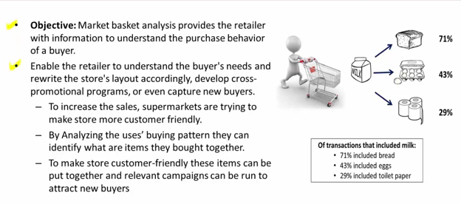
Market Basket Analysis

Slide 139
Precision Medicine
Customizing health care by tailoring treatments to the individual patient
Lifestyle
Biology
Genes
Environmental exposures
Calorie consumption

Slide 140
Recommender Systems
Systems for recommending items (e.g. books, movies, CD’s, web pages, newsgroup messages) to users based on examples of their preferences.
Many websites provide recommendations (e.g. Amazon, NetFlix, Pandora).
Recommenders have been shown to substantially increase sales at on-line stores.

Slide 141
Personalization
Recommenders are instances of personalization software.
Personalization concerns adapting to the individual needs, interests, and preferences of each user.
Includes:
Recommending
Filtering
Predicting (e.g. form or calendar appt. completion)
From a business perspective, it is viewed as part of Customer Relationship Management (CRM).

Slide 142
Research Topics in Data Science

Slide 143
Data Management
Investigating social, cultural and policy issues that affect the implementation of open data initiatives in Ethiopia
Prioritizing sectors for open data implementation
How can we use open data to solve societal problems and societal problems to enhance open data initiatives (e.g. information quality)
Improving the quality of data portals/repositories
Designing systems/applications over the existing data portals/repositories

Slide 144
Data Management
Data Integration in Big Data
Integrating information about a single subject/entity from heterogeneous information sources
Entity co-referencing problem in data warehouses, text
Web of Data
Querying the web of data
Data retrieval models
Building knowledge graphs/knowledge bases
Populating knowledge graphs/knowledge bases
Reducing inconsistencies in knowledge graphs
Data Quality in Big Data era
Privacy in the age of DS

Slide 145
Data Management
XML data integration
RDF data integration
Relational database integration
Information Integration from Heterogeneous Data Sources

Slide 146
Data Science Engineering
Adapting Models/Techniques from other disciplines for Data science
New Data Standards
Big Data Infrastructure for local contexts
Cloud/Grid/Stream Computing for Data Science
High Performance/Parallel Computing Platforms
Data Acquisition, Integration, Cleaning Best Practices
Analytics in memory
Analytics in the edges

Slide 147
Data Analytics
Assessment/Investigation
Data science in business, finance, social sciences, physical sciences, life sciences, web, marketing, precision medicine, education, health informatics, and industry
Localization/Adaptation of Models/Techniques/Algorithms
Data science in business, finance, social sciences, physical sciences, life sciences, web, marketing, precision medicine, education, health informatics, and industry
Matured Data Science Application areas
Health care, finance
Statistical Methods in Data Science
Spatial Data Analysis
Text Analytics
Semantic Text Analytics

Slide 148
Data Analytics
Banking and Securities
Communications, Media and Entertainment
Education
E-Government
International development
Manufacturing and Natural Resources
Retail and Whole sale trade
Transportation
Energy and Utilities
Web and digital media
Travel industry
Healthcare Providers

Slide 149
Discipline Definition Assignment
Groups who have tried to define data science profession
ACM Data Science Task Force (2019)
The EDISON Data Science Framework (2018)
The National Academies of Science, Engineering, and Medicine Report on Data Science for Undergraduates (2018)
The Park City Report (2017)
The Business Higher Education Framework (BHEF) Data Science and Analytics (DSA) Competency Map (2016)
Business Analytics Curriculum for Undergraduate Majors (2015)

Slide 150
Discipline Definition Assignment
Study the reports and their supporting evidences to better understand the dialogues that have been made to define the data science discipline and its knowledge areas
What is the difference and commonalities between each of the findings
How do they reach to such areas
Which finding can be adopted and why?
Evaluate your own curriculum
Undergraduate level curriculums

Slide 151
Assignment-I: Paper Review
Select one research paper that tried to conceptualize data science as a new discipline
How was data science defined or conceptualized
What are the sub knowledge areas of the discipline
What is the limitation of the conceptualization as compared with the accepted definition

Slide 152
Assignment-II: Data Science Project
Identify a problem that need a data driven solution in Ethiopia
E.g. cannot access the research data produced by Ethiopian universities
Describe why this is a problem
e.g. additional cost for data collection, not possible to compare experimental results, lack of transparency on the research procedure they followed, not convinced with their findings, decrease education quality
Identify stakeholders
MOE, Universities

Slide 153
Assignment-II: Data Science Project
Proposed Data Science Solution
Plan your own data science solution for the problem mentioned (e.g. having a national research data portal)
Convince readers how this can be a solution (use literature, experience of other countries, your own analogy)
Implementation plan
Detail activities to be done
Resources needed to implement
Software, programming languages, human resource

Slide 154
Assignment-III: Data Analytics
Identify a problem that need a data analytics solution from the following domains
Healthcare
Finance etc…
Plan the data source
Extract data from the web
Preprocess the data
Build a Model

